Slide 1

Cloud Database Encryption Technology Based on Combinatorial Encryption
AUTHORS:
Vedant Sarnobat
SY CS B
B4 1911117
Meng Chen
Xiao Fu
Bin Luo
Xiaojiang Du
Mohsen Guizani

Slide 2

CONTENTS
KEYWORDS
INTRODUCTION
STRATEGY
CONCLUSION
BIBLIOGRAPH

Slide 3
KEYWORDS
Cloud
Database
Onion encryption
Homomorphic encryption

Slide 4

INTRODUCTION

Slide 5
What Is The Objective?
Aiming at the hidden danger of data security in the cloud Database system, this paper focuses on the encryption algorithm which supports ciphertext operation.
The main design of an encrypted middle layer, while ensuring the security of the cloud database, the greatest extent to take advantage of the advantages of cloud computing.
A simplified onion encryption model is designed and implemented.

Slide 6
What Is Homomorphic Encryption?
The Homomorphic Encryption (HE) is a special kind of encryption mechanism that can resolve the security and privacy issues.
The HE allows the third-party service providers to perform certain type of operations on the user's encrypted data without decrypting the encrypted data, while maintaining the privacy of the users' encrypted data.
In a world of distributed computation and heterogeneous networking this is a hugely valuable capability.

Slide 7
The HE can be categorized into three groups based on the number of mathematical operations on the encrypted message:
Partially Homomorphic Encryption (PHE):
Only one type of mathematical operation is allowed i.e., either addition or multiplication operation as many times as we want.
Somewhat Homomorphic Encryption (SHE): In SHE,
Both addition and multiplication operation are allowed but with only a limited number of times.
Fully Homomorphic Encryption (FHE): FHE
Allows a large number of different types of evaluation operations on the encrypted message as many times as we want.

Slide 8
Encryption Algorithms
This paper uses the combination of homomorphic encryption instead of full-homomorphic encryption, which will reduce the usability of the encryption algorithm but will improve the efficiency of the algorithm.
Some of the encryption algorithm mentioned are:
AES, RSA, Paillier, OPE

Slide 9
SEGMENTS
01
Application Layer
02
Proxy Layer
03
DBMS Layer

Slide 10
Application Layer
Generate the key for the encryption algorithm
Run the application code and initiate the SQL query
Updating ciphertext

Slide 11
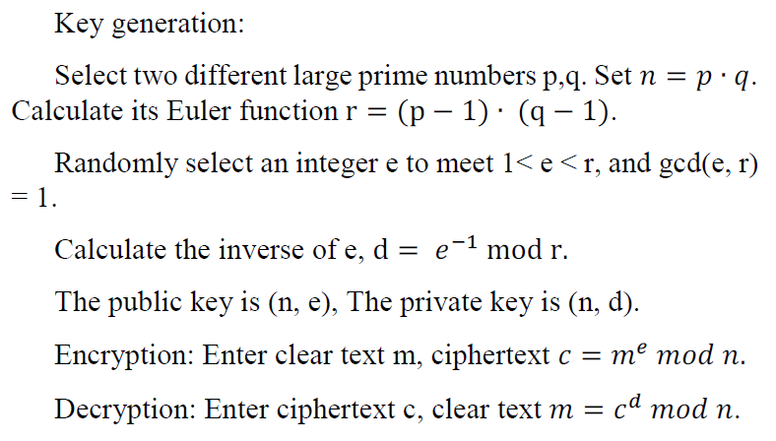
Multiplication HE Scheme

Slide 12
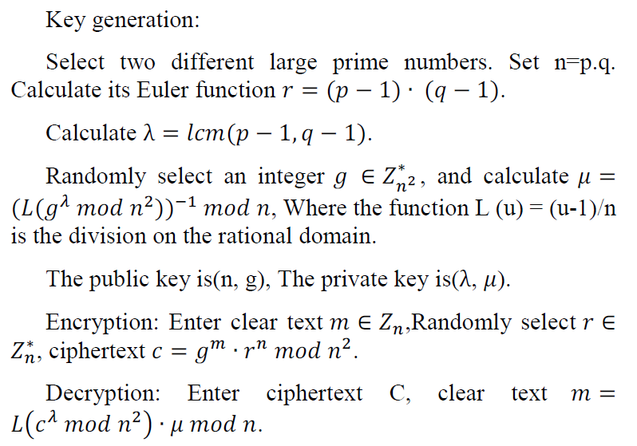
Addition HE Scheme

Slide 13
Proxy Layer
Override SQL statements, but maintain semantics
Returns the ciphertext results returned by the DBMS to the application layer

Slide 14
DBMS Layer
All data is stored encrypted
Processing encrypted data, just as it does with plaintext data

Slide 15
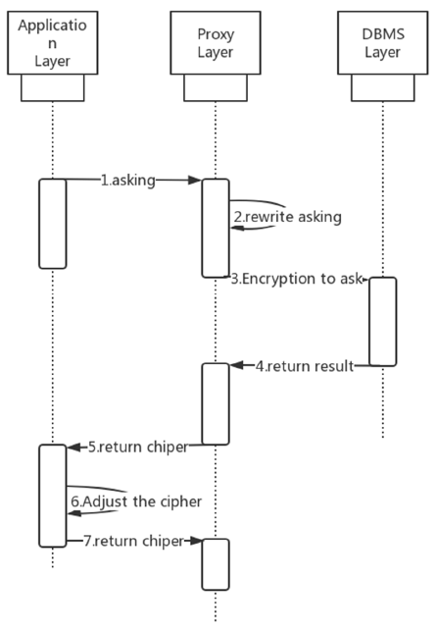
The query process
The workflow for each encryption layer

Slide 16
STRATEGY

Slide 17
Strategy
Database used will be MySQL DB
Encryption will be carried out using python
Algorithms that will be studied and implemented:
RSA
Paillier
OPE

Slide 18
Conclusion and Summary of paper

Slide 19
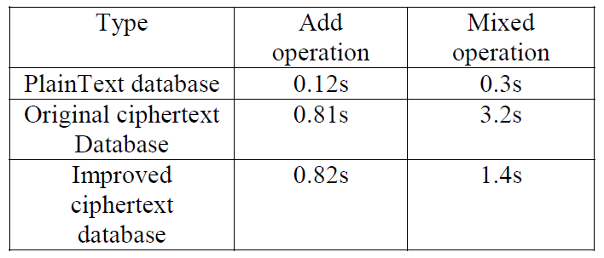
This paper selects four SQL statements to test the performance differences between the original ciphertext database and the improved ciphertext database, with the following SQL statements:
select sum(row1) from table1;
select sum(row3) from (select row1*row2 as row3 from table1);
The experimental results are as shown in the table

Slide 20
In an era when the focus on privacy is increased, the concept of homomorphic encryption is one with a lot of promise for real-world applications across a variety of industries. The opportunities arising from homomorphic encryption are almost endless.
Based on the design idea of database ciphertext processing, this paper designs an onion database encryption model under the premise that fully homomorphic encryption cannot meet the practicality, and completes the principal system of database encryption system.
How database encryption systems are deployed in a distributed environment further research is needed, and distributed databases, such as REDIS,MONGODB, may be used instead of Mysql in the future.

Slide 21
Advantages
Disadvantages
The advantage of this approach is that it is simple and straightforward
This approach not only plays the computing power and storage ability of the cloud but also avoids the data security problem on the cloud to the greatest extent.
Main disadvantage is that multiple ciphertexts need to be updated, which will result in greater network transmission pressure.
When ciphertext does one operation, only the corresponding HE text is updated, while the other HE text is not updated, so that no other operation can be performed.

Slide 22
BIBLIOGRAPHY
https://people.csail.mit.edu/nickolai/papers/raluca-cryptdb-tr.pdf
For HE:
https://www.sciencedirect.com/topics/computer-science/homomorphic-encryption
https://www.venafi.com/blog/homomorphic-encryption-what-it-and-how-it-used
https://blog.openmined.org/the-paillier-cryptosystem/
Implementation:
https://medium.com/analytics-vidhya/connecting-python-to-mysql-8330f186c2d
https://asecuritysite.com/encryption/pal_ex

Slide 23

THANK YOU

